Slide 1
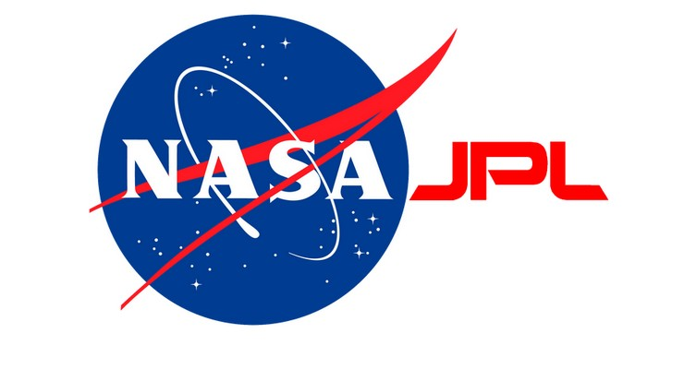

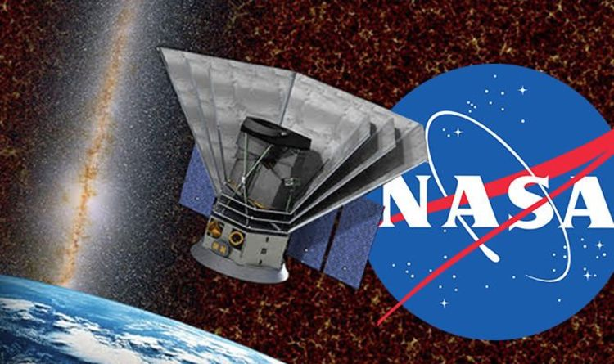

SPHEREx: The Future of Satellite Astronomy
Julian Mena, Dr. Philip Mauskopf, Dr. Sean Bryan, Pao-Yu Wang
AZSCG Symposium 2021

Slide 2
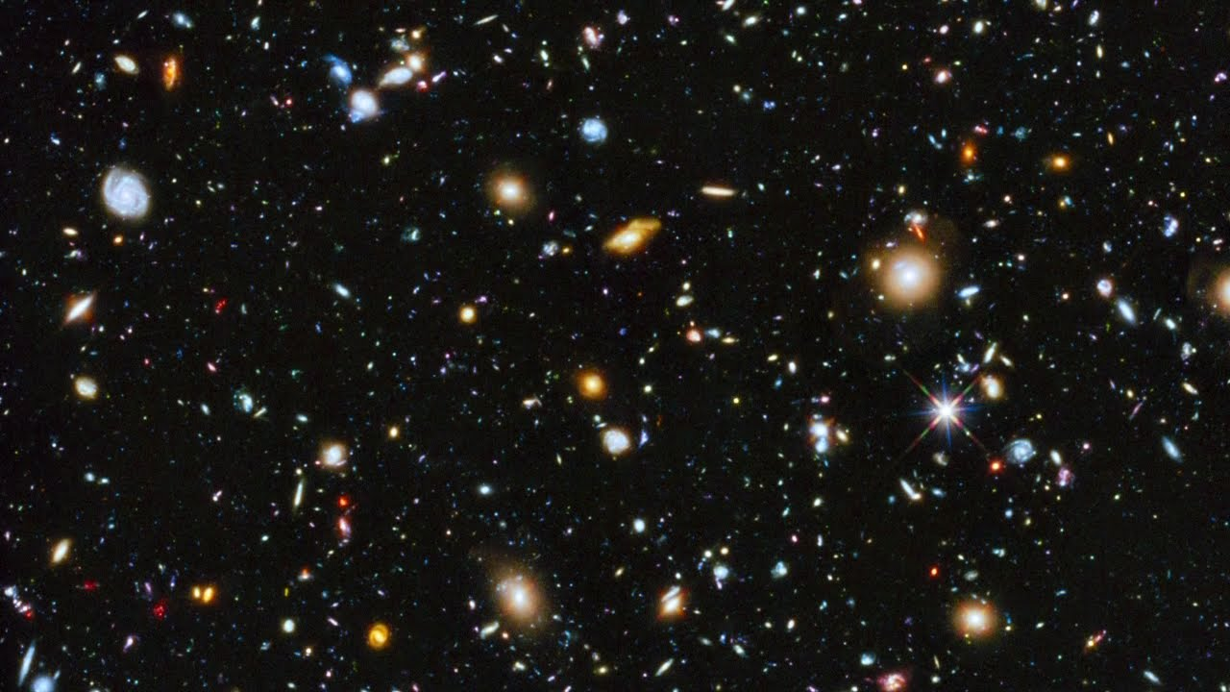
Abstract
Space telescopes have been key in the progression of space exploration, and have discovered things that were once considered science fiction. These space telescopes, however, have only been able to look at one small part of the sky at a time, leaving much of the sky unobserved. The SPHEREx Satellite Telescope seeks to solve this issue. SPHEREx will orbit the Earth longitudinally with set movement constraints in order to observe the entire sky. This will be accomplished by writing a routine in Python, which will not only tell the satellite where to look, but will also tell the satellite to avoid objects such as the Moon and Sun; it will even account for the power received from bright planets such as Jupiter, Saturn, and Mars. Current projections predict about 99% sky observance by the satellite telescope. With this increase in observed sky, countless new discoveries are sure to follow.

Slide 3
Introduction
SPHEREx is a satellite telescope set to launch in June 2024
  Code and algorithms in process of being fine-tuned
SPHEREx has a mission of observing as much of the sky as possible, and downlinking the data it collected to certain data centers as it passes by them in its orbit
Personal role to help write, edit, and test Python routines for the Satellite Telescope
  Key projects:
    Conduct test runs of the scheduler code by modifying different parameters
    Calculate the amount of light received at near-infrared wavelengths from the planets Mars, Jupiter, and Saturn

Slide 4
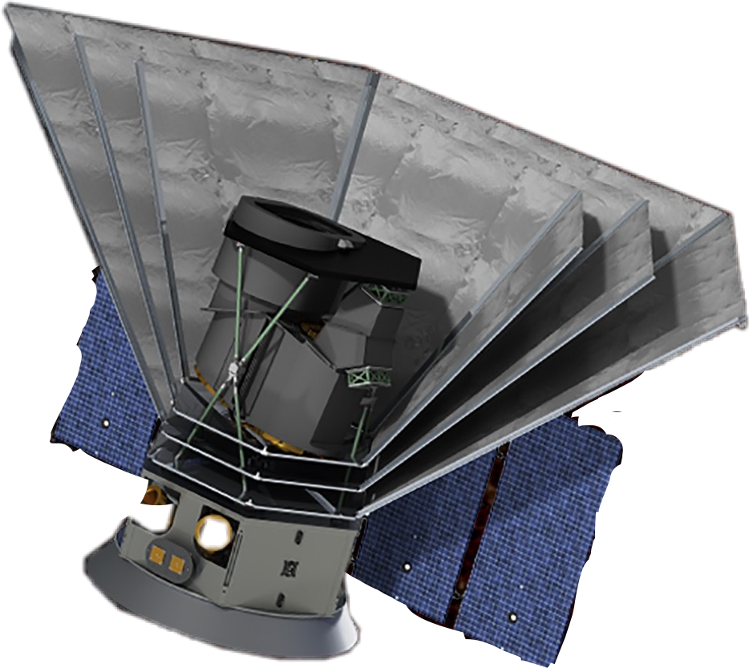
The SPHEREx Satellite
Telescope with LVF
Spectrometer
Photon Shields
Key Features
Small and compact satellite
Short mission (2-3 years)
Can observe across multiple light spectrums
No moving parts
Solar Panels
Source: https://www.express.co.uk/news/science/1087295/nasa-spherex-mission-big-bang-universe-origin-space-news

Slide 5
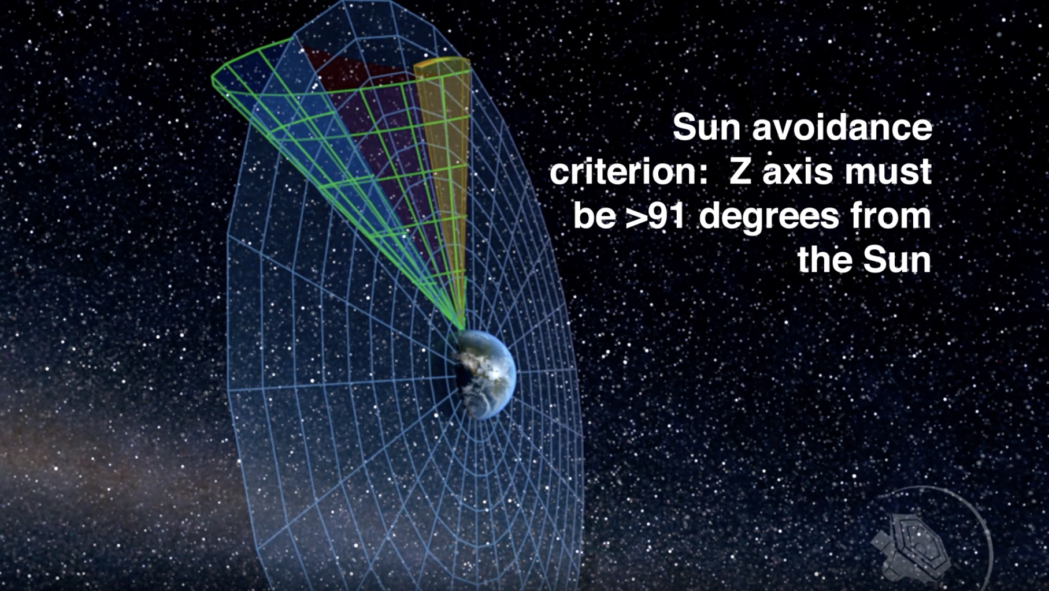
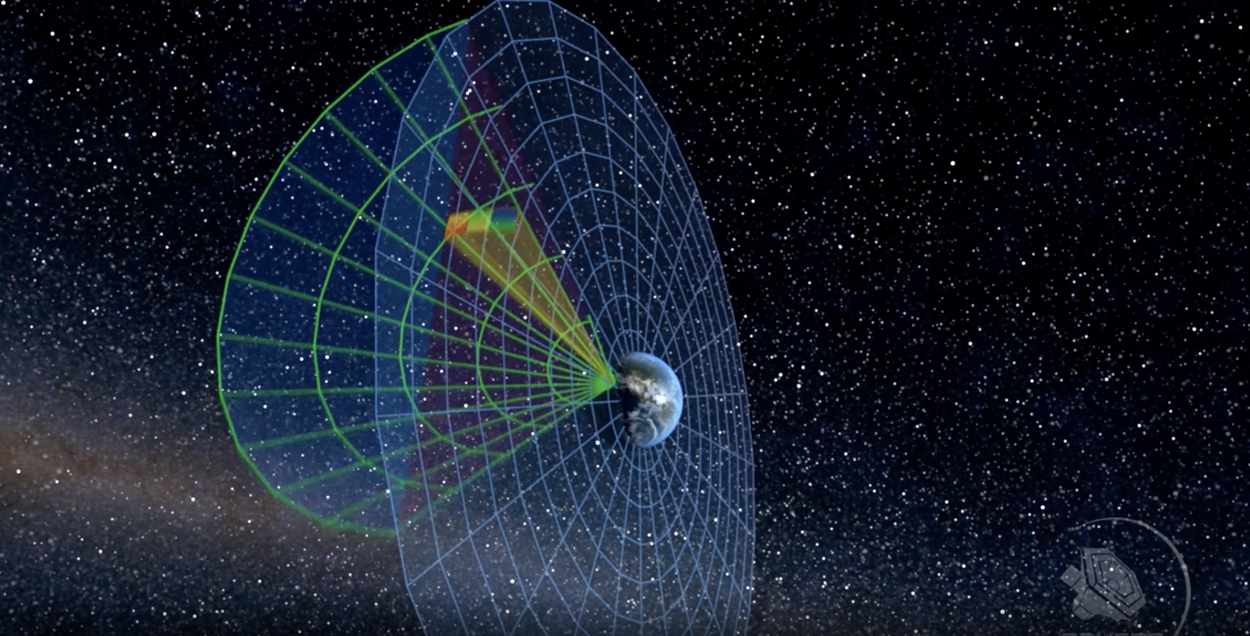
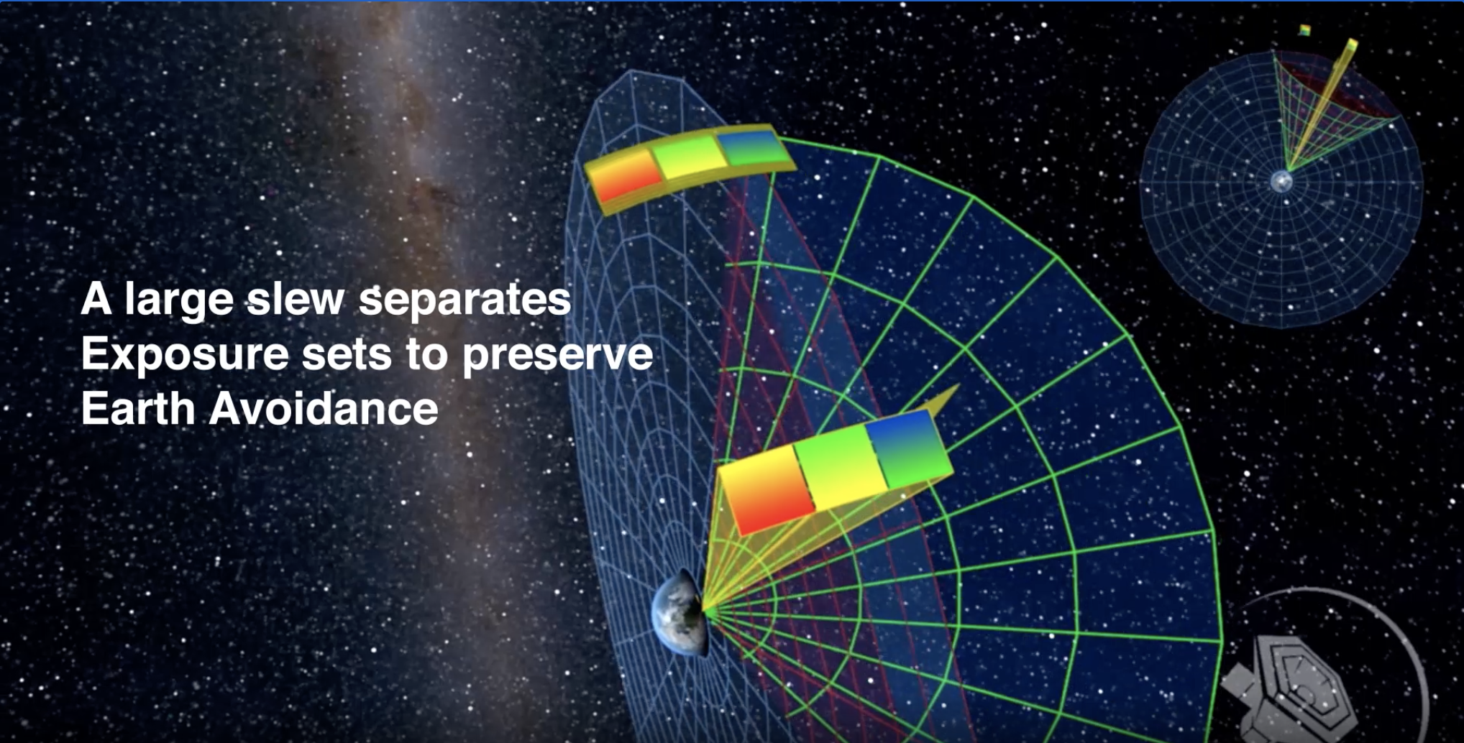
SPHEREx Slew Plan
Orbit Details/Criteria
Orbits Longitudinally
Needs to avoid Sun, Earth, Moon, and South Atlantic Anomaly
  Sun avoidance: 91 degrees
  Moon avoidance: 30 degrees
  Earth Avoidance: 40 degrees
No moving parts, so satellite must have avoidance pre-defined
Survey Diagrams Source: https://spherex.caltech.edu/Survey.html

Slide 6
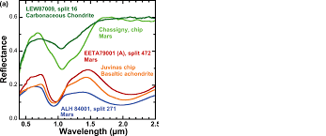
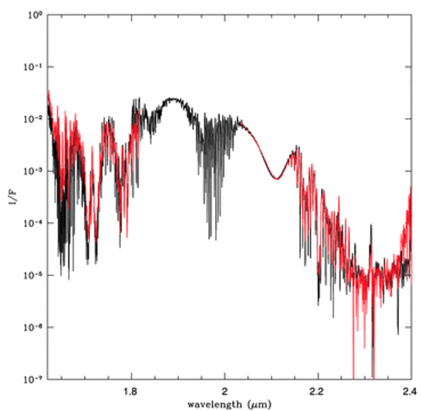
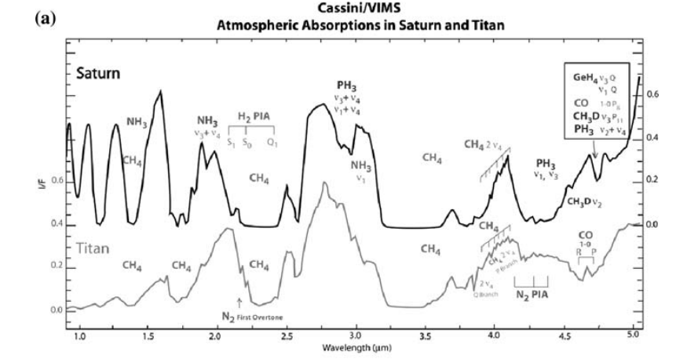
Why Care About Bright Planets?
SPHEREx has very sensitive equipment/sensors
Jupiter, Mars, and Saturn are three of the brightest objects in the sky
  Planets move quite a bit during the mission
  Venus is close to the Sun, so Sun avoidance will cover Venus avoidance
The light reflected by the planets could oversaturate SPHEREx detectors, nullifying any observations made at the time
Reflectivity of Mars at near-
Infrared wavelengths
Reflectivity of Jupiter at near-infrared wavelengths
Reflectivity of Saturn at near-
Infrared wavelengths

Slide 7
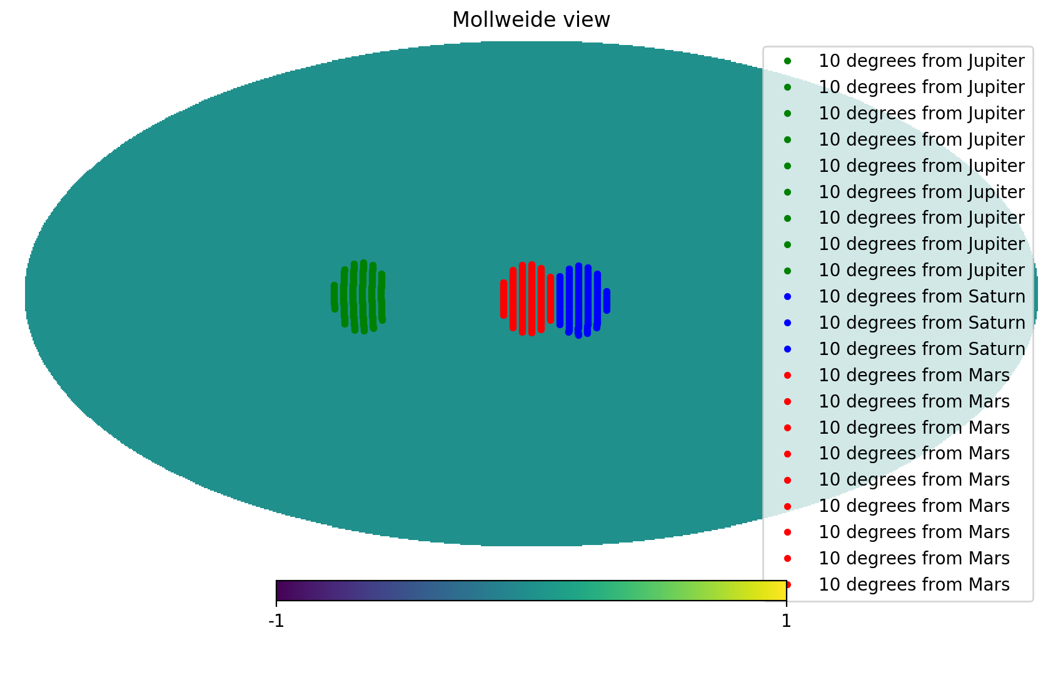

Bright Planet Locations
The following graphs are from personal software tests
These are the targets that would be affected by bright planets under a constraint of 10 degrees
  Constraints are subject to change
Survey at time = 0
Survey at time = 1 week

Slide 8
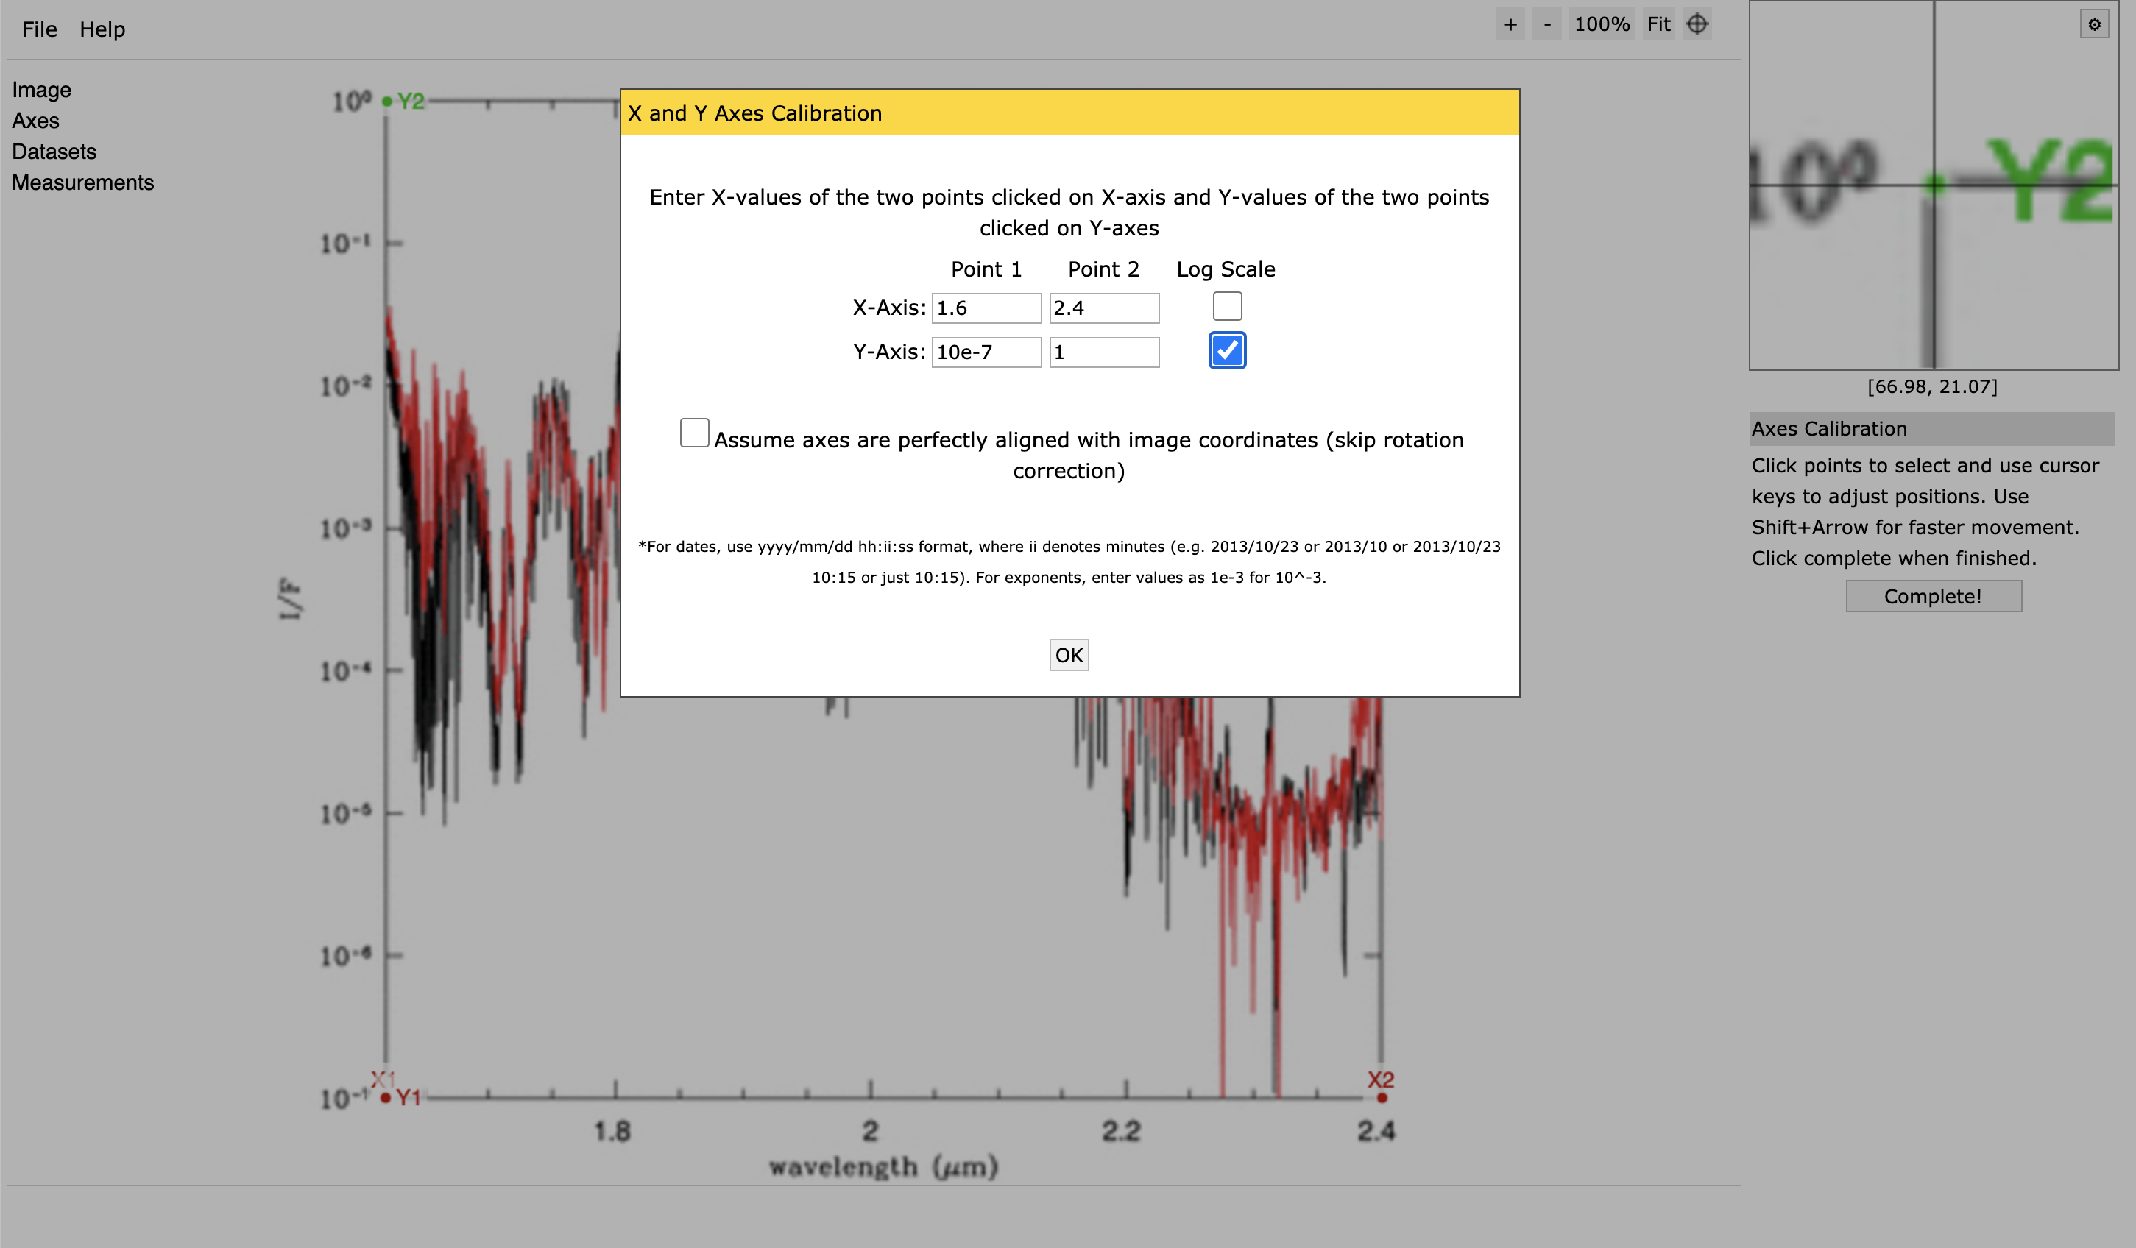
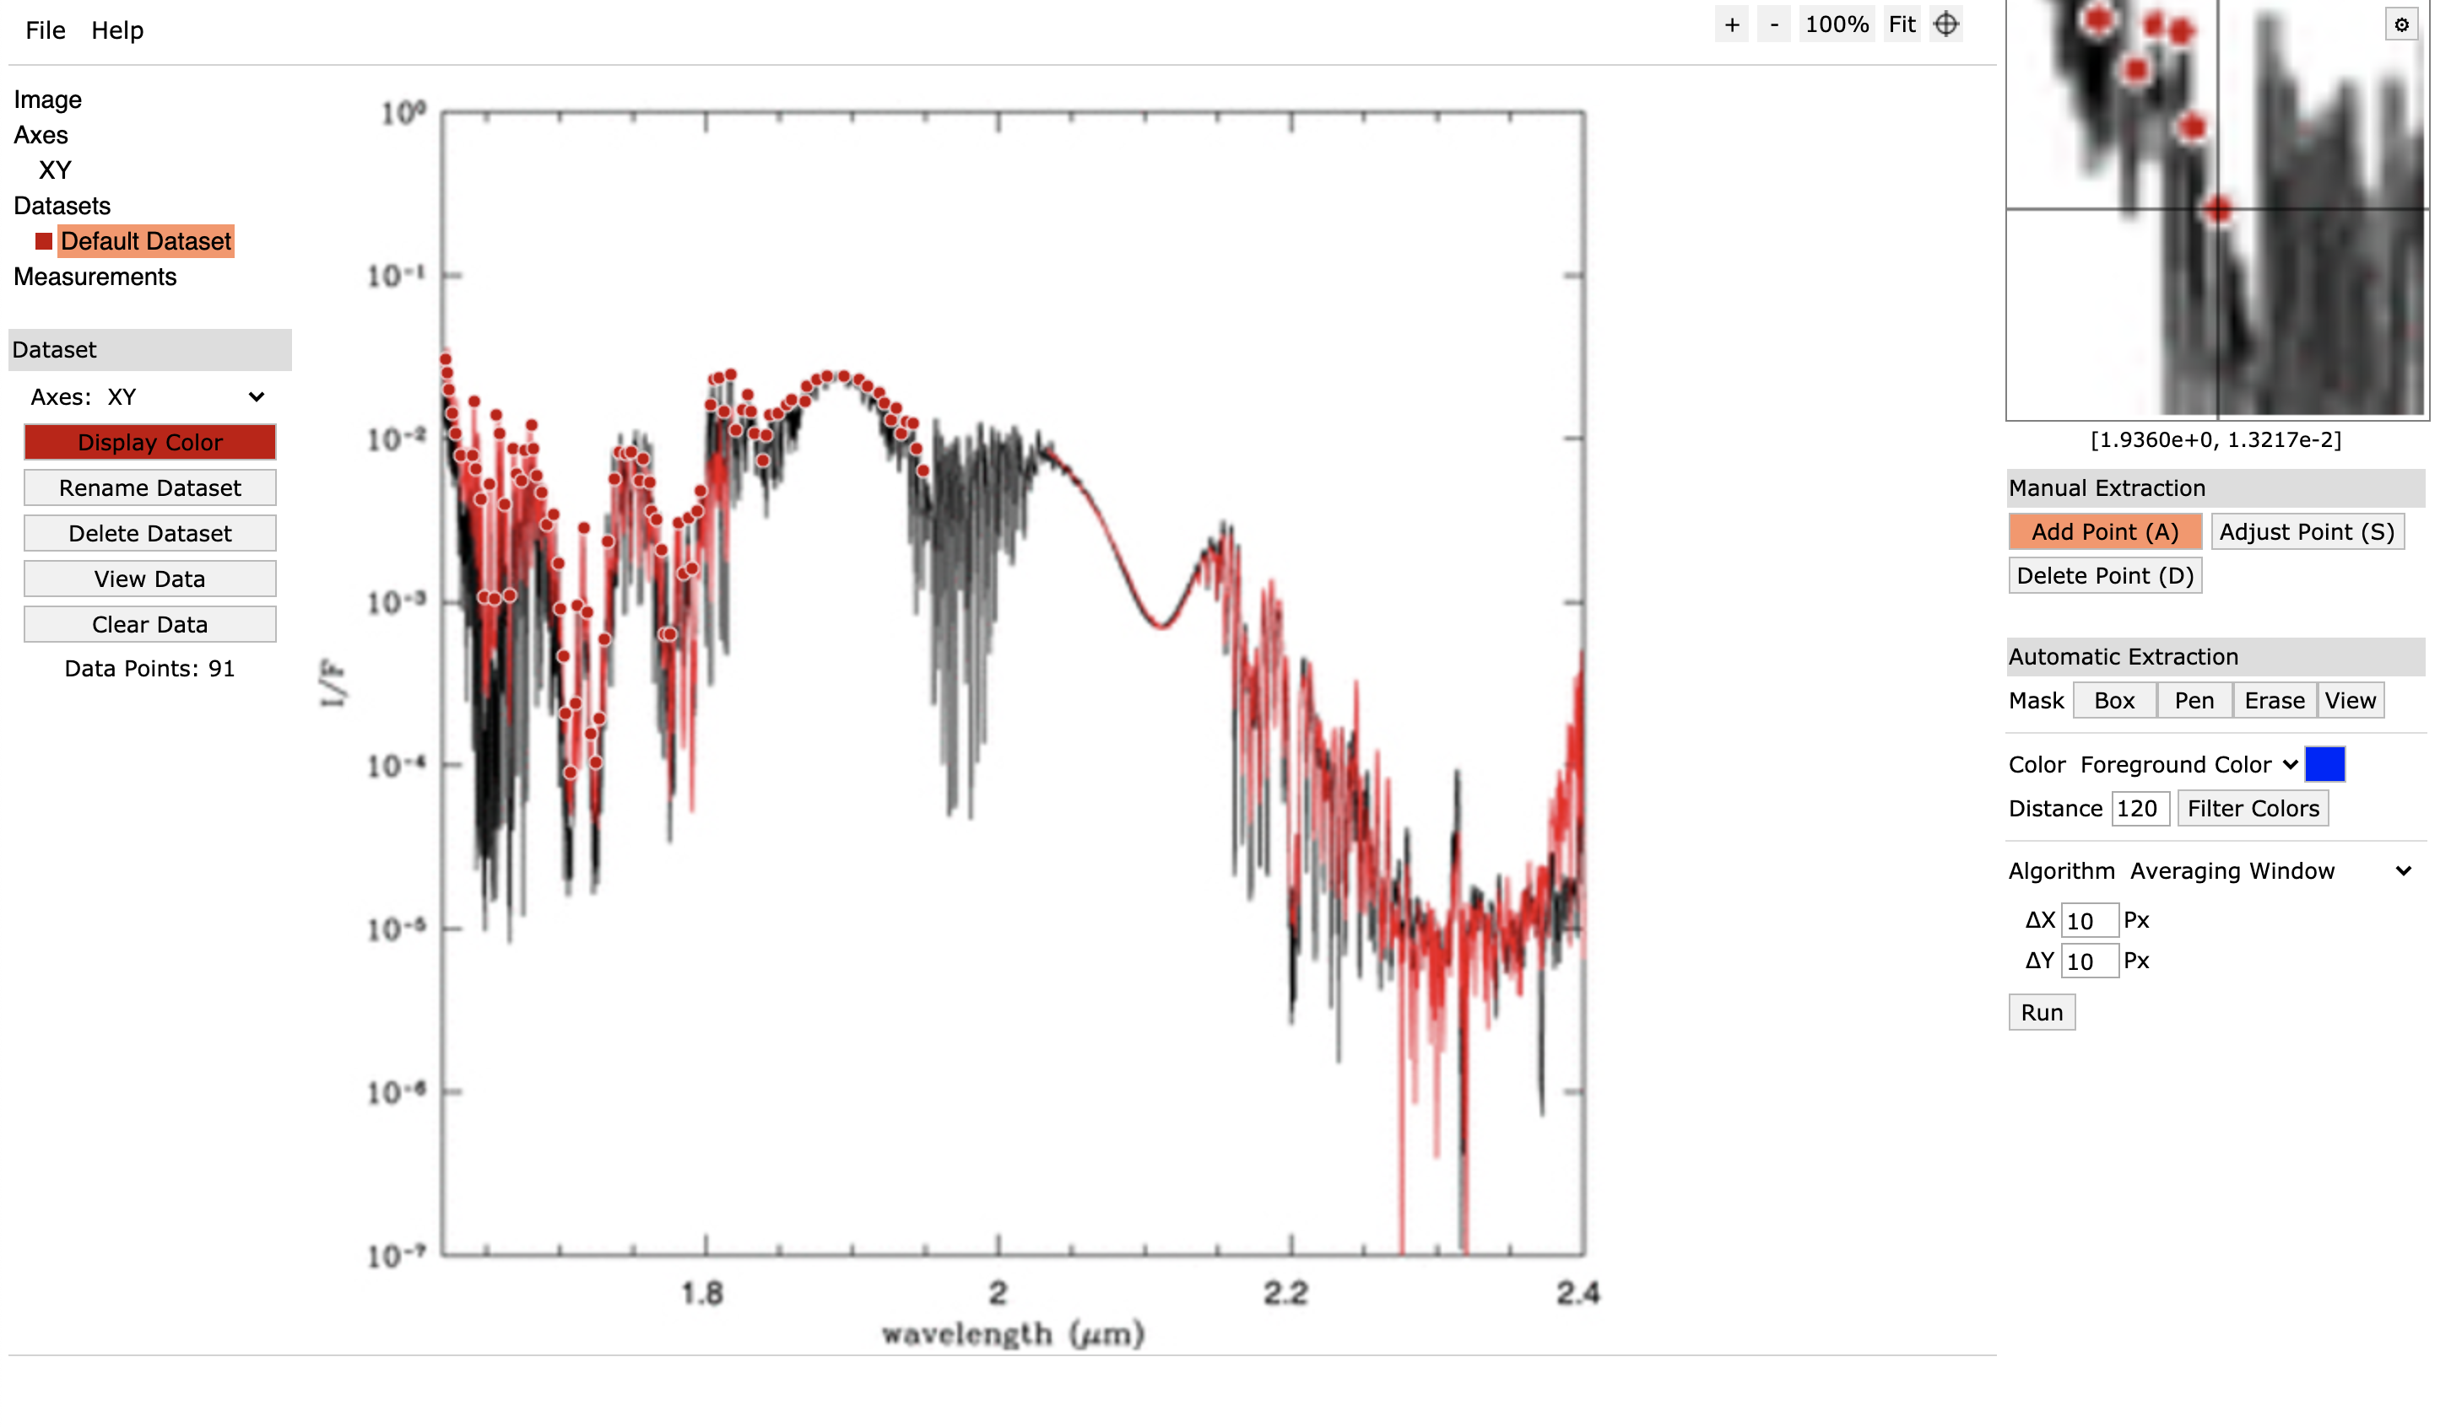
How do We Measure Planet Brightness?
Upload image to WebPlotDigitizer
Manually calibrate axes
Manually click points on graph
Export data-points to CSV file
Use CSV file to run code that calculates AB Mag at each wavelength
Not the most efficient or accurate method, but gives solid estimate of values of graph
Aligning axes
Manually selecting points on graph

Slide 9
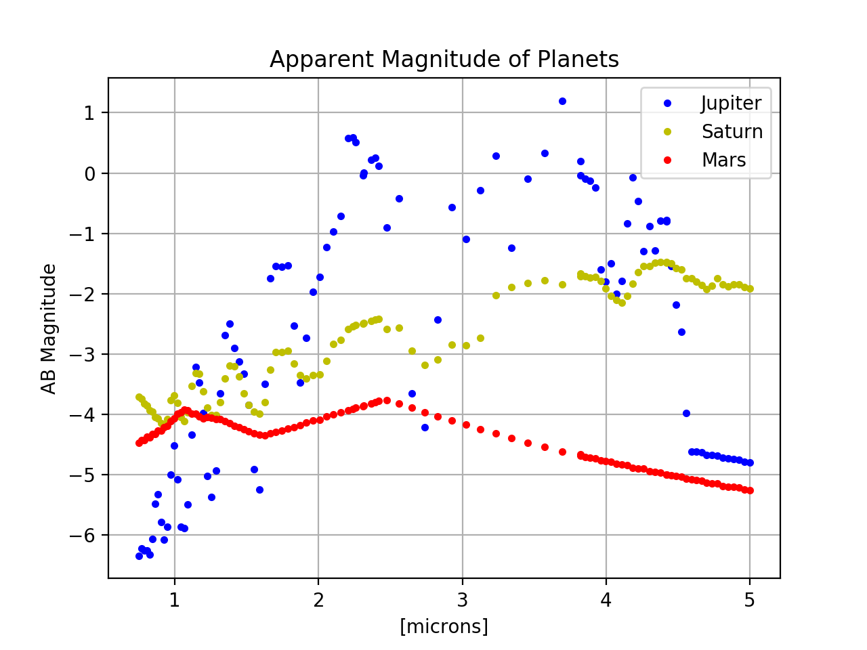
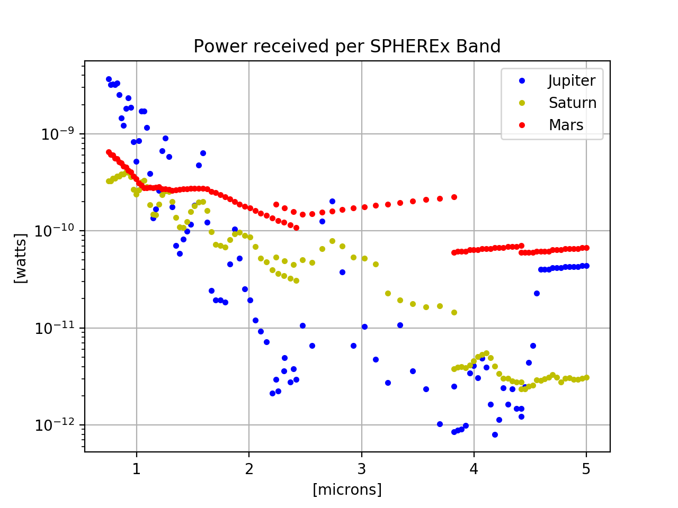
Planet Brightness Projections
Bright planets will be most disruptive to SPHEREx in the shortest wavelengths
The apparent magnitude and received power from the planets varies widely across the SPHEREx near-infrared spectrum
Some of the data-points (especially for Mars) are being interpolated due to lack of data for longer wavelengths
Approximated apparent magnitude of planets in near-infrared spectrum
The Celestial and Ecliptic Planes
Power received from planets at near-infrared wavelengths

Slide 10
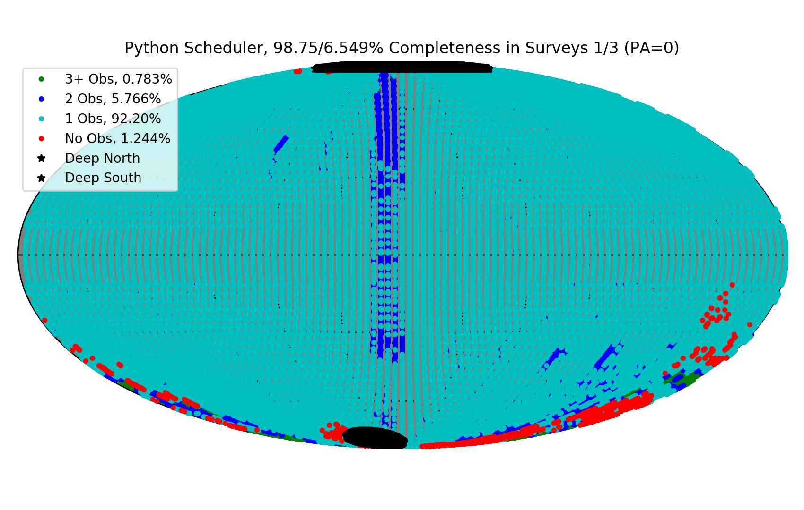
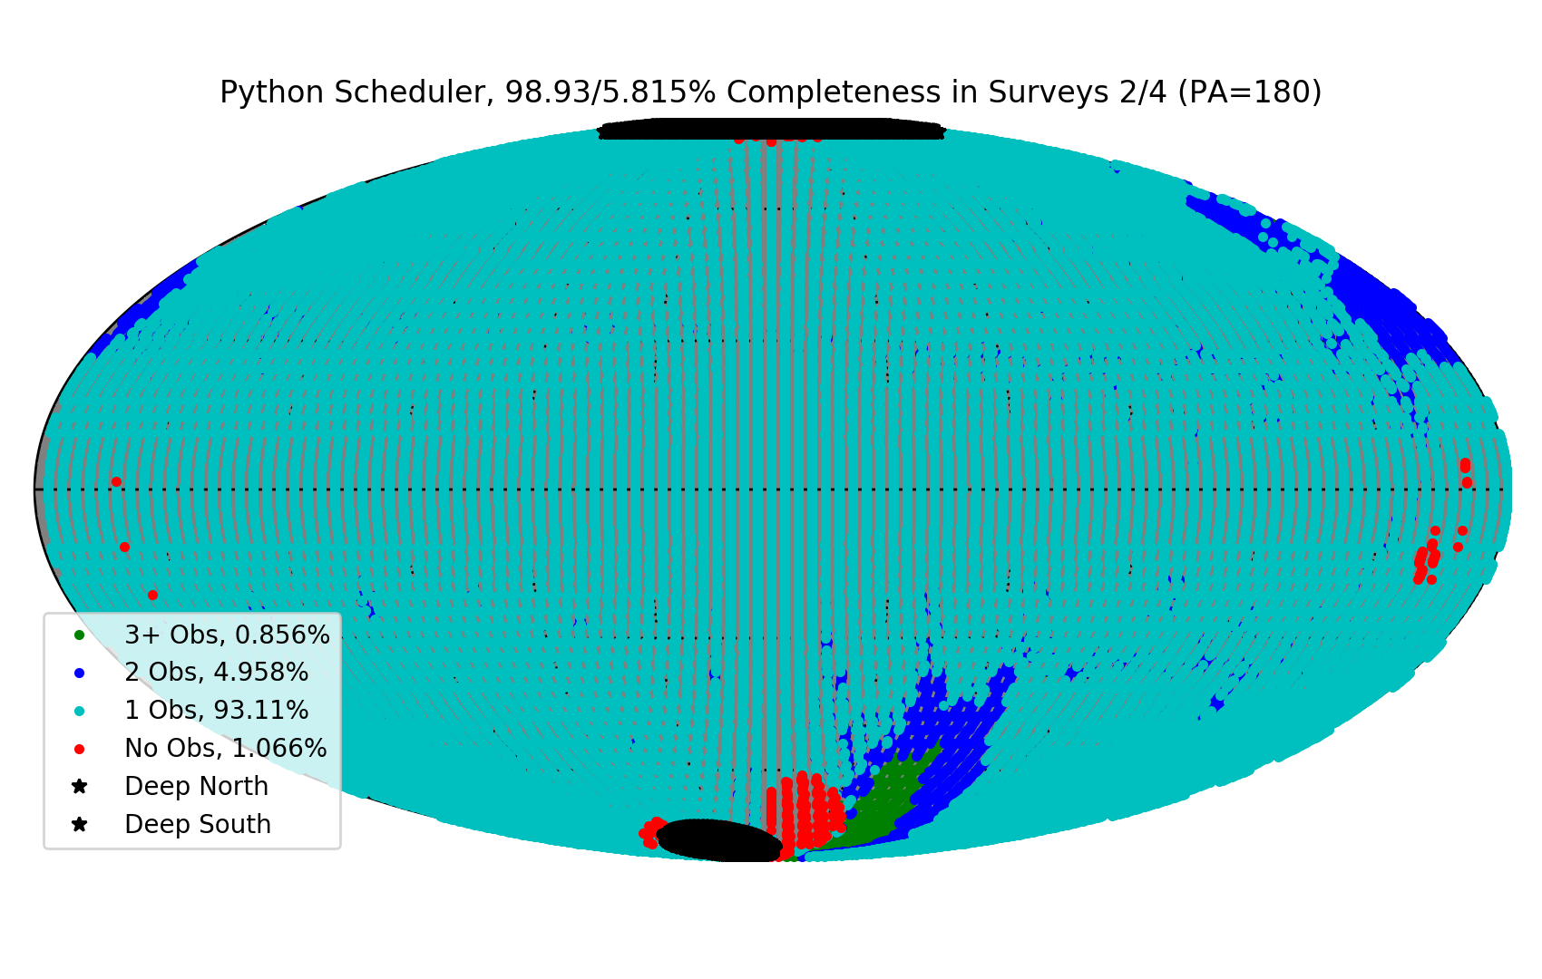
Projected Observability Results
The following graphs are from personal software tests
  Moon avoidance algorithm testing
We predict 98%-99% observability for the SPHEREx mission with current slew schedule outputs
Odd-numbered Surveys
Even-numbered Surveys

Slide 11
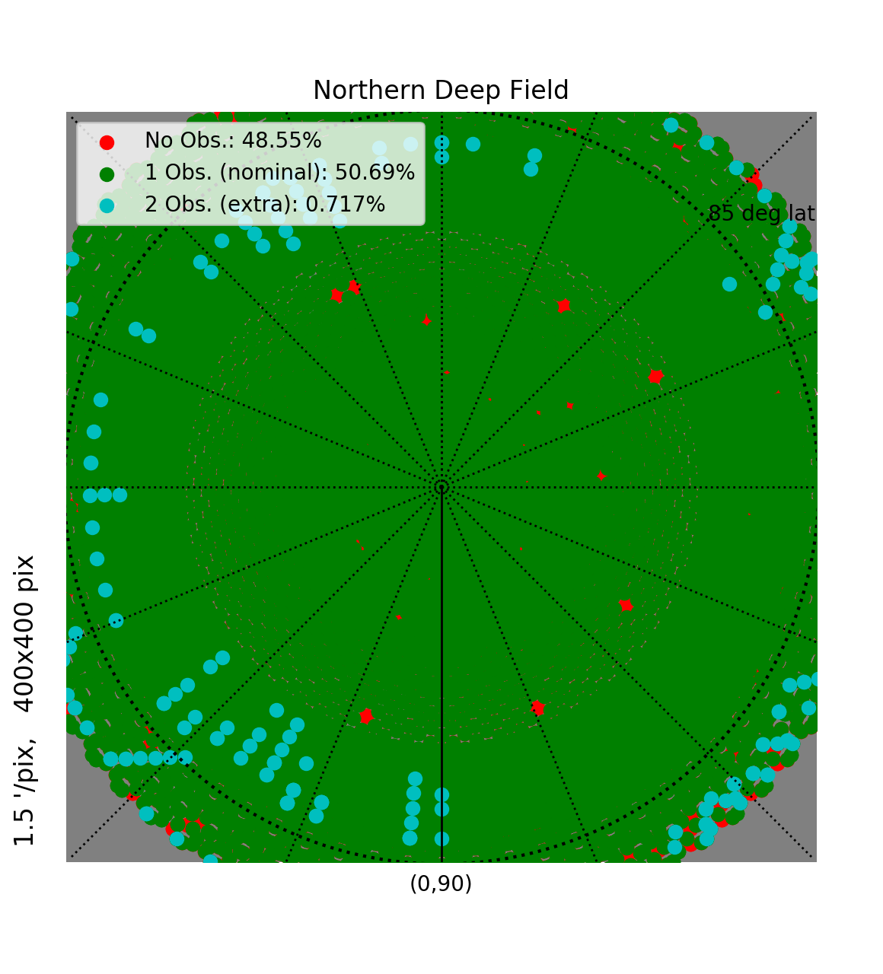
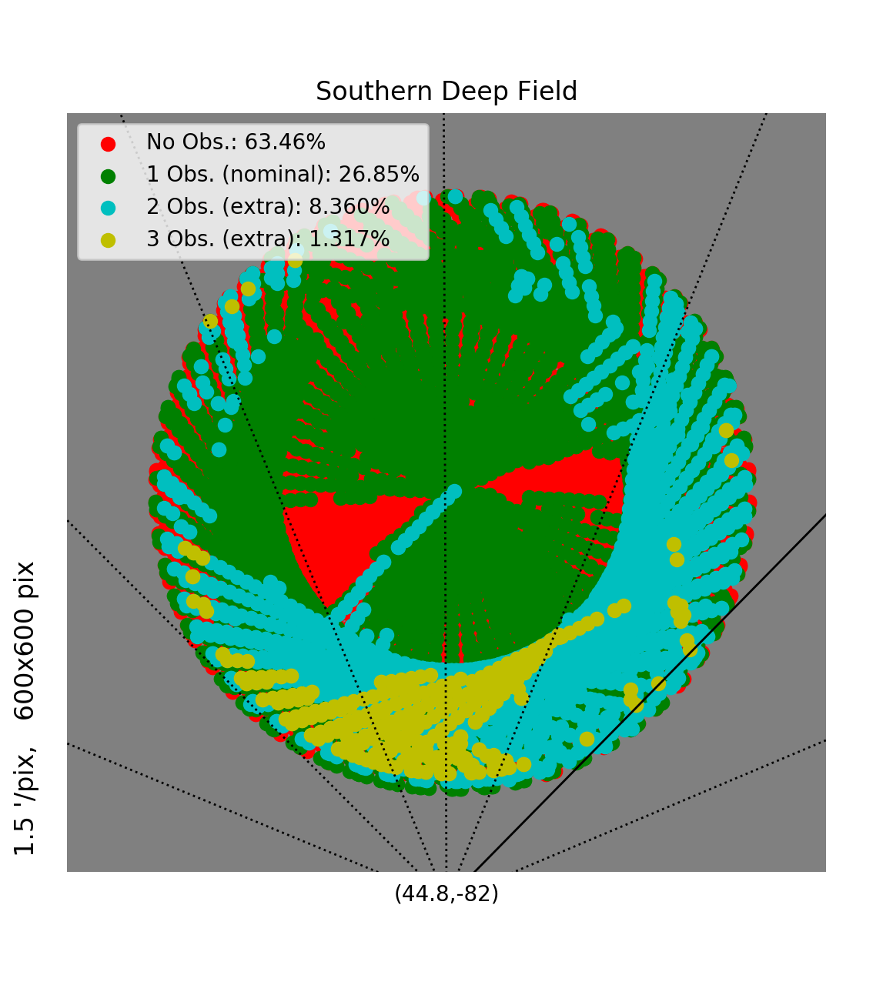
Projected Observability Results
The following graphs are from personal software tests
  Moon avoidance algorithm testing
We predict 51% visibility in the Northern Deep field, and 36% visibility in the Southern Deep Field
Northern Deep Field
Southern Deep Field

Slide 12
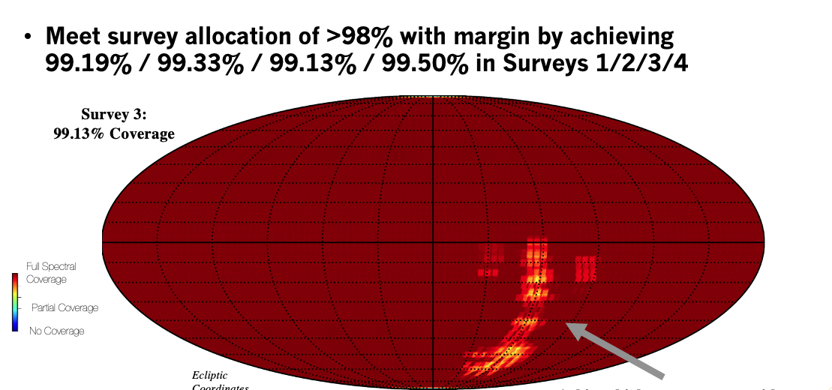
Projected Observability Results
The following graph is a more recent projection of observability and all-sky coverage
Courtesy of Dr. Sean Bryan
Source: Dr. Sean Bryan, Arizona State University

Slide 13
What Comes Next?
The next steps are to:
Get numbers from JPL related to light oversaturation
  Respective to each receptor array
  Reflectivity numbers
Continue to optimize the Python code while updating it to be able to run the newest orbit files from JPL
Work on whatever new challenges present themselves
Shortly before the mission launches, combine all Python routines into a single, automated code
Notes:
New projects present themselves almost weekly (bright planets are an example)

Slide 14
Future Implications
SPHEREx will revolutionize space exploration as we know it. The data collected by the SPHEREx mission may lead to:
Future exo-planet discoveries
A better understanding of the physics and origins of galaxies
More information about the beginning of the universe
What SPHEREx already brings to the table:
A new and innovative way to explore our universe while staying (sort of) close to home
Notes:
The possibility of finding another earth-like planet
SPHEREx will use its spectrometer to gather images from the beginning stage of galaxy formation

Slide 15
Acknowledgements
I would like to take a moment to acknowledge:
Dr. Philip Mauskopf
Dr. Sean Bryan
Pao-Yu Wang
The NASA Space Grant and NASA Space Grant Staff
The JPL staff working on the SPHEREx Project

Slide 16
References
BAINES, K.H., DROSSART, P., MOMARY, T.W. et al. (2005). THE ATMOSPHERES OF SATURN AND TITAN IN THE NEAR-INFRARED: FIRST RESULTS OF CASSINI/VIMS. Earth Moon Planet, Pages 96, 119–147, https://doi.org/10.1007/s11038-005-9058-2
Bishop, J. (2019). Visible and Near-Infrared Reflectance Spectroscopy: Laboratory Spectra of Geologic Materials. In J. Bishop, J. Bell III, & J. Moersch (Eds.), Remote Compositional Analysis: Techniques for Understanding Spectroscopy, Mineralogy, and Geochemistry of Planetary Surfaces (Cambridge Planetary Science, pp. 68-101). Cambridge: Cambridge University Press. doi:10.1017/9781316888872.006
Caltech. (n.d.). SPHEREx Science. Retrieved March 24, 2021, from https://spherex.caltech.edu/Science.html
Caltech. (n.d.). SPHEREx Survey. Retrieved March 30, 2021, from https://spherex.caltech.edu/Survey.html
Fish, T. (2019, February 14). NASA announce SPHEREx mission to see 'fingerprints' of BIG BANG. Retrieved March 26, 2020, from https://www.express.co.uk/news/science/1087295/nasa-spherex-mission-big-bang-universe-origin-space-news
Information@eso.org, NASA, & Ellis, R. (2012). The Hubble Ultra Deep Field 2012. Retrieved March 24, 2020, from https://www.spacetelescope.org/images/heic1219b/
Lucyna Kedziora-Chudczer, Jeremy Bailey, (2011). Modelling the near-infrared spectra of Jupiter using line-by-line methods, Monthly Notices of the Royal Astronomical Society, Volume 414, Issue 2, Pages 1483–1492, https://doi.org/10.1111/j.1365-2966.2011.18488.x
NASA Jet Propulsion Laboratory. (n.d.). SPHEREx. Retrieved March 30, 2021, from https://www.jpl.nasa.gov/missions/spherex/
Rohatgi, A. (n.d.). WebPlotDigitizer - COPYRIGHT 2010-2020 Ankit Rohatgi. https://apps.automeris.io/wpd/.
SPHEREx Science Team (n.d.). SPHEREx: An All-Sky Spectral Survey. Retrieved March 26, 2020, from https://cor.gsfc.nasa.gov/copag/AAS_Jan2018/spherex_aasPAGs_2018_v1.pdf

Slide 17
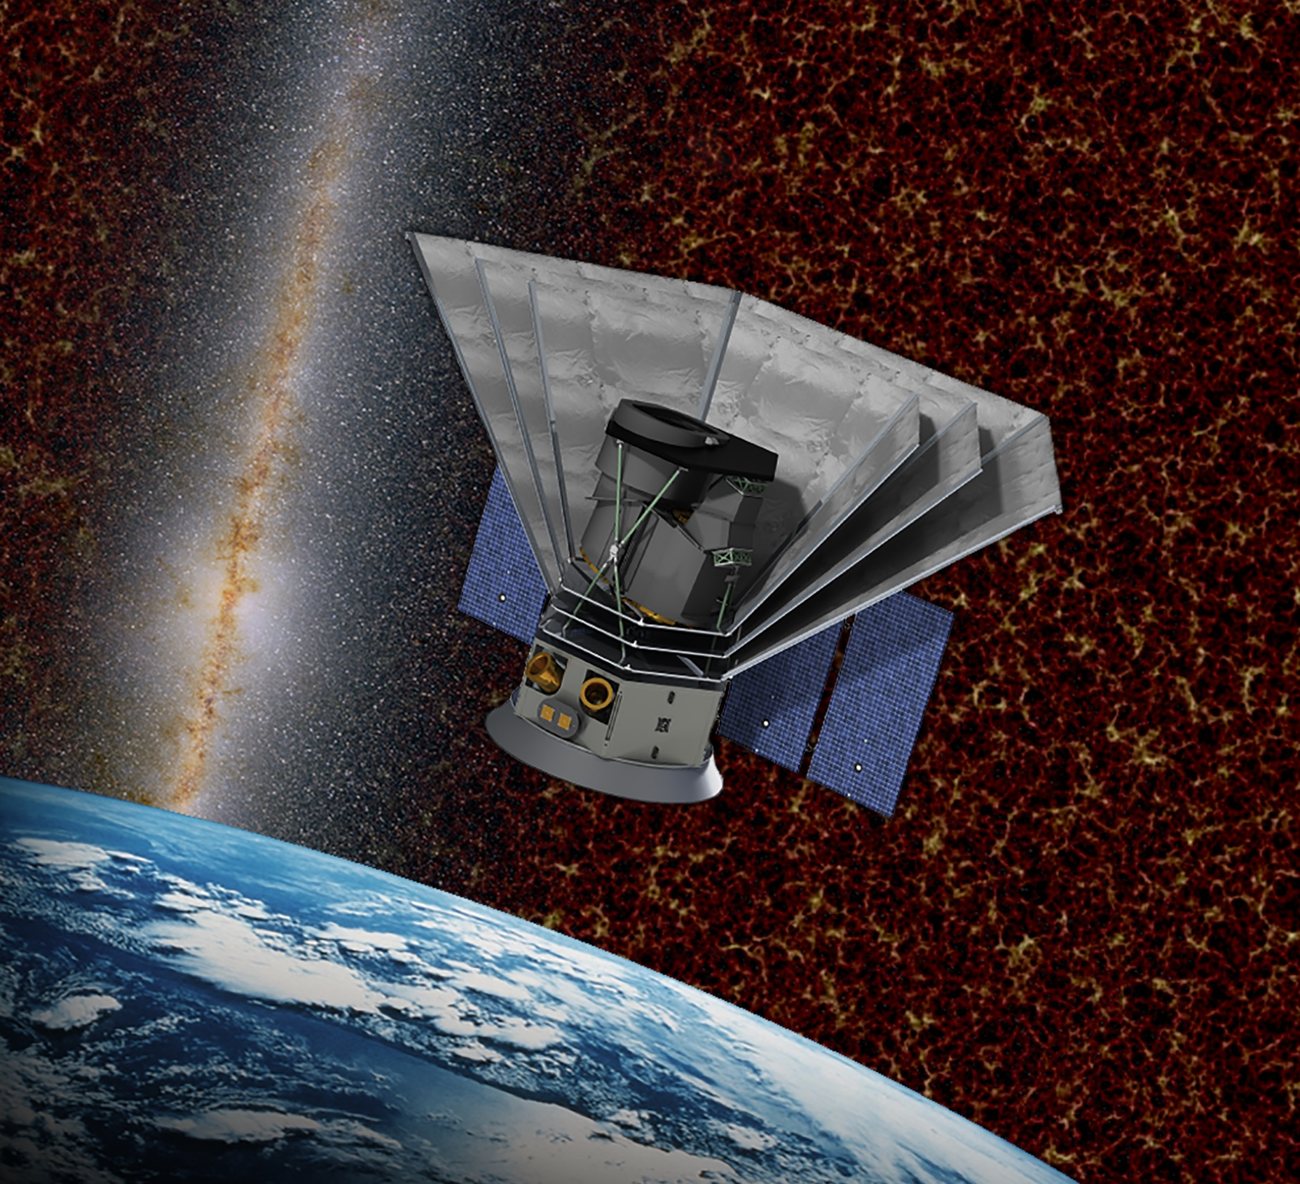
Thank you!

